Slide 1


Department of Computer Science and Engineering
CS19P11 – Internet of Things Essentials
EMERGENCY VEHICLE DETECTION AND AUTOMATED PEDESTRIAN CROSSING SYSTEM
Kaarnesh V S-210701100
Kamal Prashanth C-210701102
Karthick Ragav R-210701108

Slide 2
Abstract
The goal of this project is to prioritize emergency vehicle passage and improve pedestrian safety by implementing an innovative smart crossing system that makes use of the Internet of Things. The system uses an Arduino microcontroller to incorporate a number of sensors, such as microphones and passive infrared (PIR) sensors, to produce a thorough and clever solution. To identify the sirens and horns of oncoming emergency vehicles, microphones will be positioned in strategic locations. The Arduino will use this data to process and initiate real-time steps that guarantee emergency responders have a safe and easy way to proceed. In order to notify the system when a pedestrian approaches the crosswalk area, PIR sensors will also be installed. The project focuses on how RFID (Radio-Frequency Identification) technology might be integrated. The technology can accomplish more accurate detection by integrating RFID tags into approved emergency vehicles, thereby removing false positives caused by other cars' sirens. Traffic light timings will be dynamically adjusted based on data gathered from these sensors, giving priority to emergency vehicles and guaranteeing pedestrian safety at crosswalks. To further increase awareness and avert possible collisions.

Slide 3
Intrdouction
Ensuring pedestrian safety at busy junctions is crucial in our ever-crowding cities. By creating a smart system for emergency car detection and pedestrian safety at crosswalks, our project addresses this problem. This system integrates a variety of sensors, including microphones, RFID tags, and passive infrared (PIR) sensors, by utilizing the capabilities of the Arduino microcontroller platform. Our goal is to provide a comprehensive solution that improves pedestrian awareness and enables safe passage in emergency car scenarios by merging various technologies. The primary goal of this project is to create a working prototype system that employs easily available sensors and an Arduino microcontroller to detect emergency vehicles and ensure pedestrian safety at crosswalks.

Slide 4
Objectives
The overall objective of this project is to show how easily accessible sensor technology may be used to build an intelligent, reasonably priced smart crossing system. Using an Arduino microcontroller offers a versatile and adjustable platform for practical implementation. Significant increases in pedestrian safety at crosswalks and accelerated access for emergency vehicles are among the expected results.

Slide 5
Literature Survey
In [1] this study the article discussed about the interest in Radio Frequency Identification (RFID) technology which has grown in both academia and industry. RFID has cost-effective uses in supply chain management, non-destructive testing (NDT), and access control. It is also a viable option for ubiquitous monitoring. Battery-free RFID tags can be employed as standalone electromagnetic sensors or as an interface for data transmission and energy harvesting in sensor modules for various measurement applications.
In this [2] work, they presented a simple and practical acoustic sensing-based traffic monitoring system that records vehicle sound using an ad hoc microphone array. Ad hoc microphone array signals are asynchronous, thus compensating for sampling frequency mismatch and the difference between the beginning and ending of the recording to achieve channel synchronization. Using peak detection of the power envelopes to monitor traffic by estimating the number of cars and classifying the traffic lane based on the difference in the microphones' propagation periods.

Slide 6
Problem Statement and Motivation
Ambient noise can mask sirens, while poor visibility due to blind spots or inclement weather can mask visual signs. These restrictions put drivers in potentially hazardous situations at intersections, especially when there are emergency vehicles around. Because of the urgency of their task, they must pass immediately. The goal of this initiative is to greatly increase pedestrian safety at crosswalks, especially when emergency vehicles are approaching. In order to do this, we will create a system that uses a mix of PIR sensors and microphones to accurately identify emergency vehicles. After that, this data will be utilized to efficiently notify pedestrians through audio and visual alerts; it may even be integrated with current traffic signals to provide a more complete warning system.

Slide 7
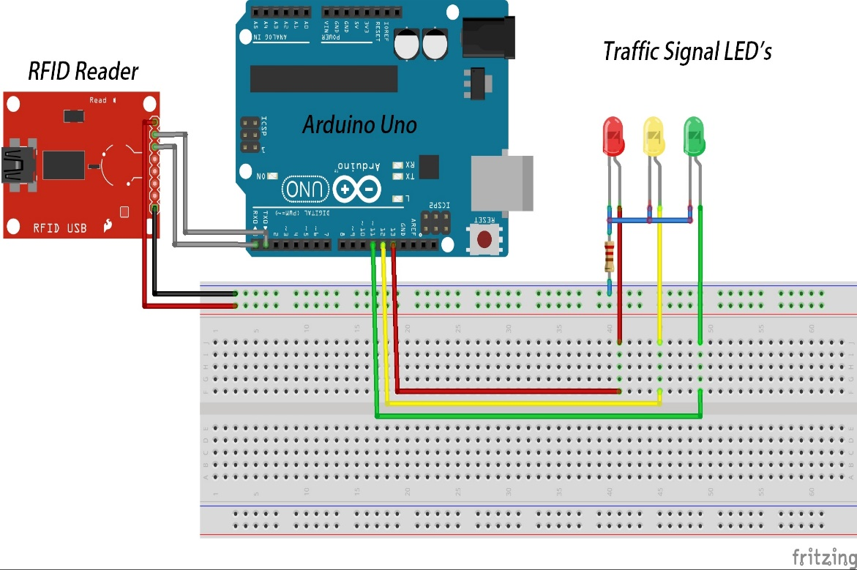
System Design
CIRCUIT DIAGRAM:
The circuit diagram explains the connections made with the hardware components and the board. The Arduino uno is connected with the breadboard as the VCC and GND are connected with the rails. The Sensors, LED and RFID Reader module is given connection with the rails and the other input/output pins are connected to digital as per the requirements.

Slide 8
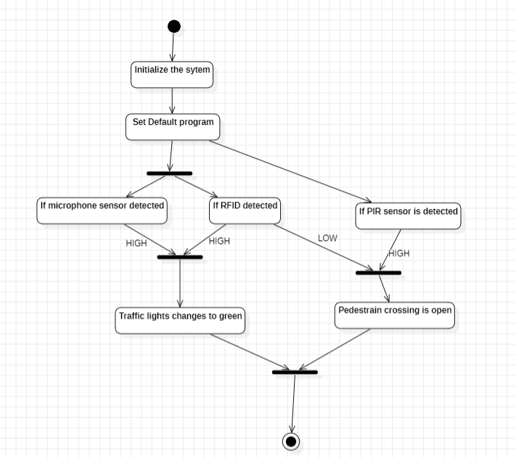
System Design
FLOW DIAGRAM:
The flow diagram illustrates a traffic management system that uses a microphone sensor, RFID reader, and PIR sensor to control traffic lights and pedestrian crossings. The system initializes and sets a default traffic light sequence. When a loud noise is detected by the microphone sensor and an authorized RFID tag is read, the traffic light changes to green for an emergency vehicle. Simultaneously, if the PIR sensor detects a pedestrian, the pedestrian crossing light is turned on. If no pedestrian is detected, the system continues its default operation. This ensures that emergency vehicles are prioritized while maintaining pedestrian safety.

Slide 9
List of Modules
ARDUINO UNO:
This is microcontroller setup for the emergency vehicle detection and automated pedestrian crossing which acts as the CPU of the w hole system. This takes inputs from the Sensors and triggers the actuators.
MICROPHONE-SENSOR:
This sensor is used to trigger an event at the time of emergency vehicle’s entry sends the information to the controller.
LCD MODULE:
This module is used to identify people’s motion in the pedestrian crossing and send information to the RFID.

Slide 10
List of Modules
LED-LIGHTS:
This module is the actuator of the system which acts as the traffic light for our system and controlled based on the decisions taken by the controller of the system.
RFID:
This is used as a communication medium between the LED module and the vehicle just utilizing 4 digital pins from the controller for communication.

Slide 11
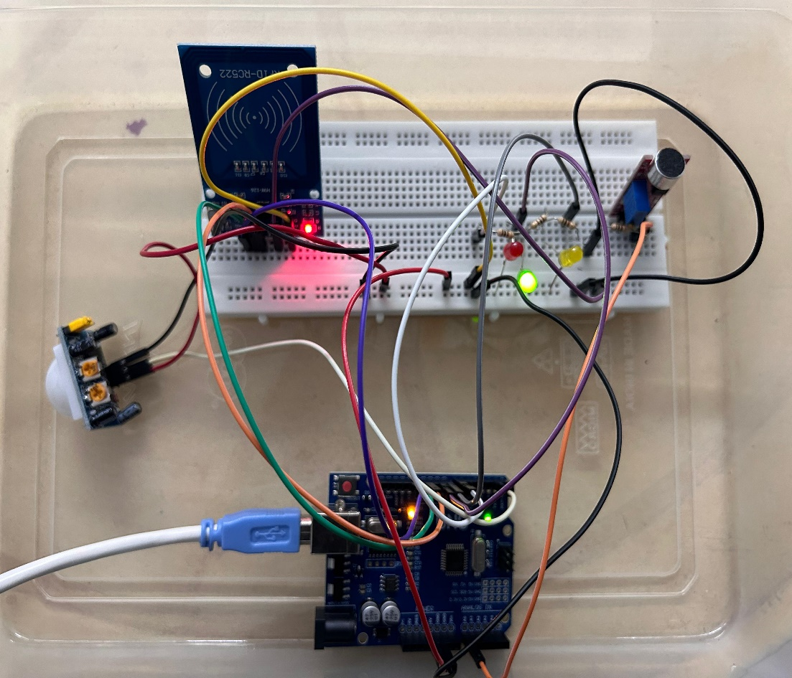
Implementation/Results of Module
Upon successful connection, this project simulates a smart traffic light system. It uses an Arduino to control LED lights based on sensors. A PIR sensor detects pedestrians for crosswalk timing. An RFID reader (optional) identifies emergency vehicles with tags, giving them priority. The system prioritizes pedestrian and emergency vehicle safety.

Slide 12
Conclusion
For countries that are developing, this project proposes a smart traffic management system concept that gives priority to emergency vehicle movement during peak hours. Constructed using an Arduino, an RFID reader, an optional microphone, and LED displays, the prototype effectively replicated real-time traffic situations and showcased the essential features
RFID provides accurate identification, but further research into techniques such as connecting emergency vehicle dispatch systems or using cameras that can recognize license plates could improve detection accuracy even more. Strong security measures must be put in place to stop unwanted access and system manipulation. Expanding the usage of this technology in developing nations would require identifying components that are affordable and optimizing power consumption.

Slide 13
References
[1] Meng, Z., & Li, Z. (2016). RFID Tag as a sensor - A review on the innovative designs and applications. Measurement Science Review, 16(6), 305–315. https://doi.org/10.1515/msr-2016-0039
[2] Yousef, K. M. A., Al-Karaki, J., & Shatnawi, A. M. (2010). Intelligent traffic light flow control system using wireless sensors networks. ResearchGate. https://www.researchgate.net/publication/220586947_Intelligent_Traffic_Light_Flow_Control_System_Using_Wireless_Sensors_Networks
[3] Chanda, J. (2021). Density based traffic control system using Arduino. Social Science Research Network.
https://doi.org/10.2139/ssrn.3917889
[4] Traffic monitoring with ad-hoc microphone array. (2014, September 1). IEEE Conference Publication | IEEE Xplore. https://ieeexplore.ieee.org/abstract/document/6954310

Slide 14
Github Links
Github Links:
https://github.com/KarthickRagav/210701108-CS19P11-IOT.git
https://github.com/Wizhunter21/210701102-CS19P11-IOT.git
https://github.com/kaarneshvs/210701100-CS19P11-IOT.git

Slide 15
Thank You

